Slide 1
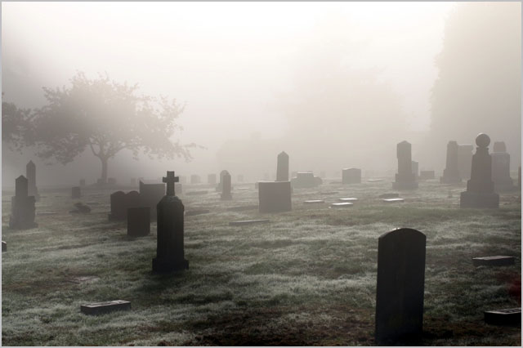
Distinguished Yet Dead
The Church of Sardis (Rev. 3:1-6)
Dr. Rick Griffith • Singapore Bible College • BibleStudyDownloads.org

Slide 2
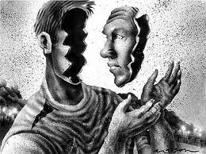
How well do you know yourself?

Slide 3
Jim Keenan
Notes:
Jim Keenan is a motivational speaker who runs a website called asalesguy.com. I ran across it this week and found this observation of his very insightful. He writes,
One of our biggest challenges in life is self-assessment. We think we know ourselves pretty well, however the science says different.
As a leader, personal self-assessment is critical to success. We have to be able accurately assess our abilities.
We all have blind spots. Our blind spots are those things that others know about us, that we are unaware of. Our blind spots are those things others see in us, that we can't see in ourselves.

Slide 4
http://asalesguy.com/2012/12/11/how-well-do-you-know-you/
Known to others and myself
Known only to others
Open
Blind Spot
Hidden
Unknown
Known only to myself
Known to no one
Notes:
Johari's window sums it up nicely like this:
The Open – what others know about us and what we openly share with others
The Hidden – what we know about ourselves that others don't know. (What we keep hidden from site)
The Unknown – what we don't know about ourselves and what others don't know
The Blind Spot – what others know about us, that we don't know about ourselves
The blind spot is where we get tripped up. It's the reason we fail and seem perplexed because we thought we did everything right. It's the date that we thought went awesome yet they don't want to go out with us again. It's the co-worker feeling belittled after you thought you had a super productive meeting. The blind spot is the part of us we just don't see that the rest of the world does that screws everything up.
Do you know your blind spot(s)? Ask around, everyone else does.

Slide 5
How well do you know yourself?

Slide 6
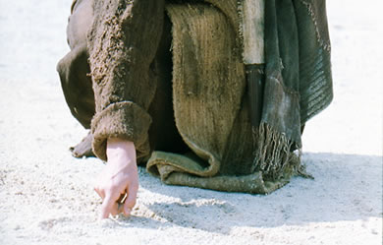
What does Jesus think of you?
Notes:
We have NO actual accounts of Jesus writing anything except what he wrote in the sand in John 8—and we have no idea what he wrote!

Slide 7
If Jesus wrote a letter to our church, what would Jesus say?
R
Revelation

Slide 8
Revelation
The Seven Churches of Revelation
The Writing Ministry of Jesus
This is the third to last of the seven letters of Revelation 2–3

Slide 9
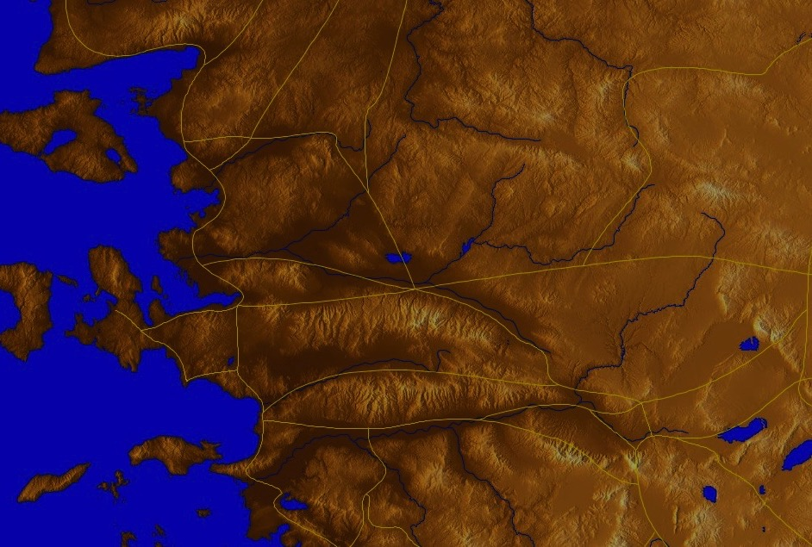
The 7 Churches (Rev. 2–3)
345
Adramyttium
Aezani
Pergamum
Thyatira
Cyme
Erythrae
Sardis
Smyrna
Eumenia
Philadelphia
Lebedus
Colophon
Ephesus
Nysa
Laodicea
Hierapolis
Trailes
Heraclea
Aphrodisias
Colossae
Alabanda
Patmos
Miletus
Notes:
Jesus designed a brilliant strategy by having his revelation sent to capital of the province, Ephesus. It included an individual letter to Ephesus, as well as letters to 6 other key churches. The Ephesians copied the entire book of Revelation, though, and sent the original to the next city, Smyrna. Smyrna then made their own copy and sent the original to Pergamum, which lay on the main road to the north. This city then sent the prophecy to Thyatira, which sent it to Sardis, then Philadelphia, and finally to Laodicea.

Slide 10
The 7 Churches (Rev. 2–3)
345
Pergamum
Thyatira
Sardis
Smyrna
Philadelphia
Ephesus
Laodicea
Notes:
These 7 churches were neither the largest, nor the most influential cities in Asia Minor. However, they were strategically located on a key highway that linked them all.
[Animate} From their own locations we understand that they also copied the prophecy and sent these copies to other churches near them.

Slide 11
7 Church Stages?
347
Mistreated yet Missions-Minded
Suffering yet Steadfast
Continuing yet Compromising
Distinguished yet Dead
Busy yet Backslidden
Involved yet Immoral
Luxurious yet Lukewarm
Modern Missions Era
Reformation
Constantine
Middle Ages
Materialistic
Apostolic Age
Church Fathers
33
100
313
476
1453
1795
1900
Philadelphia
Ephesus
Smyrna
Pergamum
Thyatira
Sardis
Laodicea
Notes:
Some scholars over the years have believed that these churches represent 7 stages of church history:
33—The Apostles of Christ pass on the gospel, but by AD 95 the love at Ephesus had grown cold
100—Last Apostle died (John) with the message passed on to their disciples, called the "Church Fathers"
313—Constantine began to merge Christianity and paganism. With paganism illegal, it took on a "Christianized" form.
476—Rome's Fall ushered in 1000 years of deviation from classical learning called the "Middle Ages" with Rome's influence through the RCC
1453—The conquest of Constantinople by the Turks began the Renaissance, followed by the Reformation
1793—William Carey left England for India, sparking the movement of the gospel from the West to the Two-Thirds World
1900—The decline of Christianity in Europe began to be replaced with humanism, materialism, modernism, and post-modernism

Slide 12
Four Views on Rev. 2–3
345
Pergamum
Historic Churches
Historico- Prophetical
Prophetic View
Thyatira
Sardis
Smyrna
Philadelphia
Ephesus
Laodicea
Typical (Representative)
Notes:
Four Views:
Historic Churches: The 7 churches were actual churches at John's time. All actually hold to this view except Bulllinger, who in 1935 taught seven churches are seven Jewish congregations in the future Tribulation period. Almost all see these as depicting seven churches that can be found in any age.
Prophetic: The chapters deal purely with stages of church history without identifying any first century church, shown by remarkable resemblance to successive eras of church history (taught by Cohen, Understanding Revelation, 48-49; and J. A. Seiss, The Apocalypse [London: Marshall, Morgan, and Scott, n.d.], 76-86).
Historico-Prophetical: The churches depict BOTH historic churches of the first century and stages of church history. "This approach is commonly taken in dispensational commentaries; see e.g., Herman A. Hoyt, The Revelation of the Lord Jesus Christ (Winona Lake, IN: BMH, 1966) 17,25-29, and John F. Walvoord, The Revelation of Jesus Christ (Chicago: Moody, 1966) 52, who holds the view cautiously. See also Menno J. Brunk, "The Seven Churches in Revelation 2-3," BSac 126 (1969) 240-46, and Gary G. Cohen, Understanding Revelation (Collingswood, NJ: Christian Beacon, 1968) 44-65, who presents a more impressive argument. Of course, the prophetic view is held by non-dispensationalists as well (e.g., J. P. Lange, Commentary on the Holy Scriptures- Revelation [reprint; Grand Rapids: Zondervan, n.d.] 139). See also the survey of R. C. Trench, Commentary on the Epistles to the Seven Churches in Asia (6th ed., rev.; reprint; Minneapolis: Klock and Klock, 1978) 237-45" (James L. Boyer, "Are the Churches of Revelation 2–3 Prophetic?" Grace Theological Journal 6.2 [1985] 267-273). He answers YES.
Typical (Representative): They were real churches, but also represent types of churches found throughout church history. Therefore, this view is also called the typical or representative view.
Critique of Each View:
Historic Churches: The doubt about whether all of the churches existed is flawed—just because we don't know about each of them does not mean they did not exist (argument from silence)
Historico-Prophetical: Church history had not 7, but 3, stages: Ancient (to 590), Medieval (590-1517), and Modern (1517-present); designations are arbitrary (e.g., is Sardis pre-Reformation or the Reformation itself?)
Prophetic: (a) Any prophetic element would destroy the doctrine of imminency, so the chapters must relate only to actual first century churches since the 4th and 6th letters refer to Christ's imminent coming, and Philadelphia would be given a false hope of deliverance from wrath (3:10) if the church had to wait until the "Laodicean age." (b) Nothing in these chapters or elsewhere in the NT hint at these being stages of church history. (c) These letters differ from the prophetic portions of the book (Rev. 4–22) in that they are simply epistles similar to those written by Paul.
Typical (Representative): (a) Imminency would be ruined only "if it stated explicitly there would be a period of at least two thousand years before the second advent, or even if it had stated explicitly that there would be 'seven periods of church history' (Boyer, 269-70. (b) These seven churches do not represent all types of churches of the first century or any other, for other types exist besides these (e.g., Galatian or Corinthian), and "seven" better pictures the whole of the church age than would the 3 stages proposed above.

Slide 13
Christ has authority over all churches
344

Slide 14
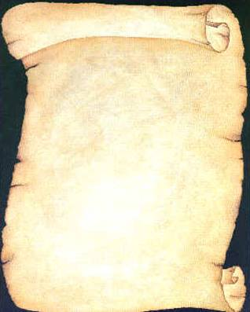
So Jesus wrote 7 churches (Rev. 2–3)
Ephesus
Smyrna
Pergamum
Thyatira
Sardis
Philadelphia
Laodicea

Slide 15
Revelation
Sovereignty of Christ in Future Victory
Sovereignty in His Person |  |  | Sovereignty over Churches | Sovereignty in End-Time Events
Chapter 1 |  |  | Chapters 2–3 | Chapters 4–22
"What you have seen" (1:19a) |  |  | "What is now" (1:19b) | "What will take place later" (1:19c)
Past |  |  | Present | Future
Christ Unveiled |  |  | Churches Unveiled | Consummation Unveiled
God on Earth |  |  | God's Ambassadors on Earth | Hell on Earth to Heaven on Earth
The Judge |  |  | The Assignments | The Judgments & Rewards
Subject 1:1-3 | Worship of Trinity 1:4-8 | Glorified Christ 1:9-20 | Seven Churches of Asia: Ephesus Smyrna Pergamum Thyatira Sardis Philadelphia Laodicea | Tribulation 4:1–19:10 | Second Coming 19:11-21 | Millennium 20 | Eternal State 21:1–22:5 | Closing: Imminency 22:6-21
AD 95
318, 324 M

Slide 16
The 7 Churches (Rev. 2–3)
Promise
348
Pergamum
Warning
Thyatira
Exhortation
Rebuke
Commendation
Smyrna
Sardis
N/A
Christ
N/A
N/A
N/A
Ephesus
Philadelphia
N/A
Laodicea
Notes:
Though some exceptions exist (noted with "N/A" above), the basic pattern of the seven letters is a sevenfold outline:
Church name
Christ Described in a Unique Way for that Church
Commendation of Good Deeds among the Believers
Rebuke of Sin within the Church
Exhortation or Encouragement to Repent
Warning if the Exhortation is Disobeyed
Promise for Faithfulness
Notice also that each letter not only begins with a reference to Christ but ends with an appeal from the Spirit.

Slide 17
Clint Eastwood 1966
THE GOOD
THE BAD
AND THE UGLY

Slide 18
Christ knows it all
The Church of Sardis (Rev. 3:1-6)

Slide 19
I. Jesus knows the good.

Slide 20
Jesus encouraged Sardis with the good news that he was sovereign and knew their faithfulness (3:1-2a)
345
Adramyttium
Aezani
Pergamum
Thyatira
Cyme
Erythrae
Sardis
Smyrna
Eumenia
Lebedus
Colophon
Ephesus
Nysa
Hierapolis
Trailes
Heraclea
Aphrodisias
Colossae
Alabanda
Patmos
Miletus
Notes:
Jesus designed a brilliant strategy by having his revelation sent to capital of the province, Ephesus. It included an individual letter to Ephesus, as well as letters to 6 other key churches. The Ephesians copied the entire book of Revelation, though, and sent the original to the next city, Smyrna. Smyrna then made their own copy and sent the original to Pergamum, which lay on the main road to the north. This city then sent the prophecy to Thyatira, which sent it to Sardis, then Philadelphia, and finally to Laodicea.

Slide 21
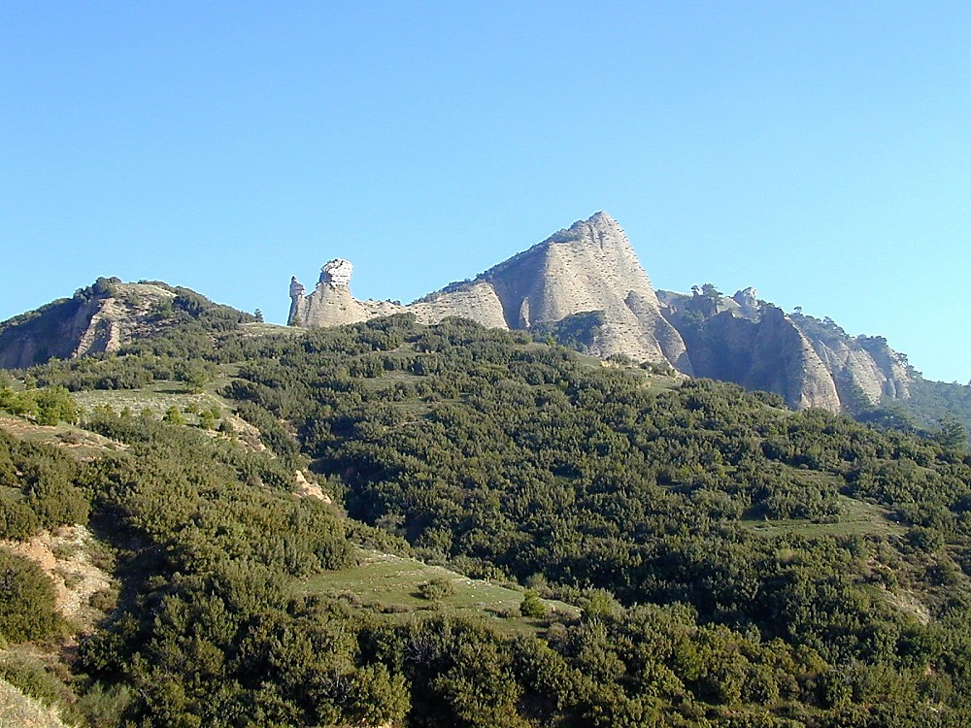
Sardis acropolis from below
Sardis Acropolis from Below
Notes:
Historical Background
Sardis was a city of Roman Asia, located in western modern-day Turkey. The acropolis of Sardis, large and imposing, is part of the edge of the mountain range Tmolus, forming a natural fortress difficult to penetrate. Unfortunately, few ruins have been found upon it.
Lydia—Founded in 1200 B.C., Sardis was the capital of the Lydian kingdom under King Gyges. It was a prosperous city, especially under Croesus; its wealth was thought to come from the Pactolis River, which ran through the ancient city. According to mythology, this was the river of the great Phrygian King Midas, in which he washed to cleanse himself of his "golden touch," which even turned his food to gold. Gold found on the banks of the Pactolis was used for the production of gold coins during this time.
Persia—When Kings Cyrus of the Persians besieged and took the city (then called Pers Sparda) in 546 B.C., Lydian control came to an end. Cyrus took the citadel by means of scaling the cliffs in the dark of night, a method repeated years later (214 B.C.) by Antiochus the Great.
Greece—Alexander the Great gave Sardis its independence in 333 B.C. Sardis was under Seleucid control from 270-190 B.C.
Rome—In 188 B.C. the Romans defeated Antiochus III and gave Sardis to King Eumenes II of Pergamos, who held control until 133 B.C. when it came back to Roman power. Sardis honored various Roman Caesars and remained a prominent city until ca. 26 A.D., when it lost out to Smyrna for the privilege of building the imperial temple.

Slide 22
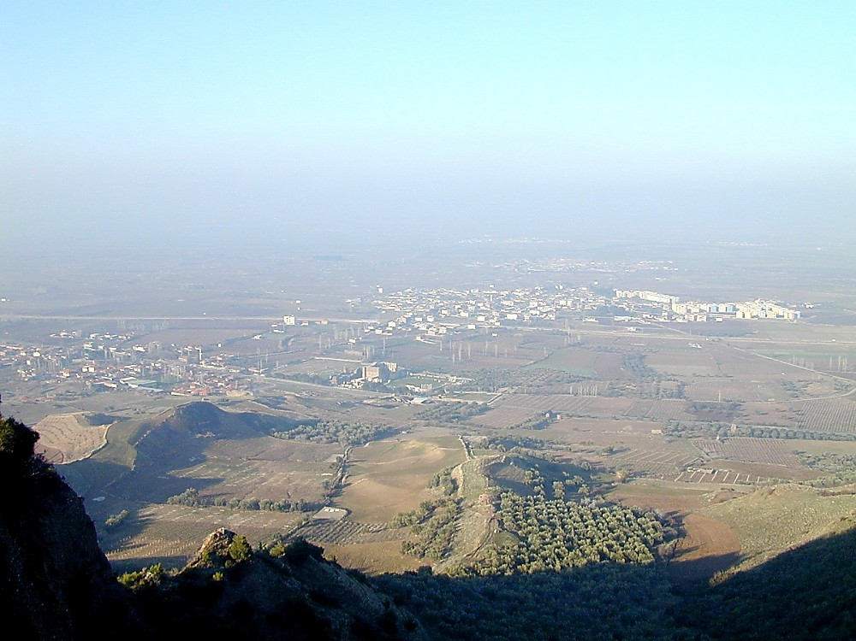
Sardis from acropolis
Sardis from Acropolis
Notes:
Biblical Significance
Sardis became an important center for Christianity during Roman times. In fact, it is one of the seven churches to whom the John wrote the letters mentioned in Revelation 1:11. However, John's letter to Sardis (Revelation 3:1-6) reveals that the attitude of the believers in the city reflected that of the city as a whole, resting on past reputation and not being faithful. In fact, Sardis was more completely rebuked than any city, aside from Laodicea. Sardis remained a center for Christianity well into the 14th century A.D.

Slide 23
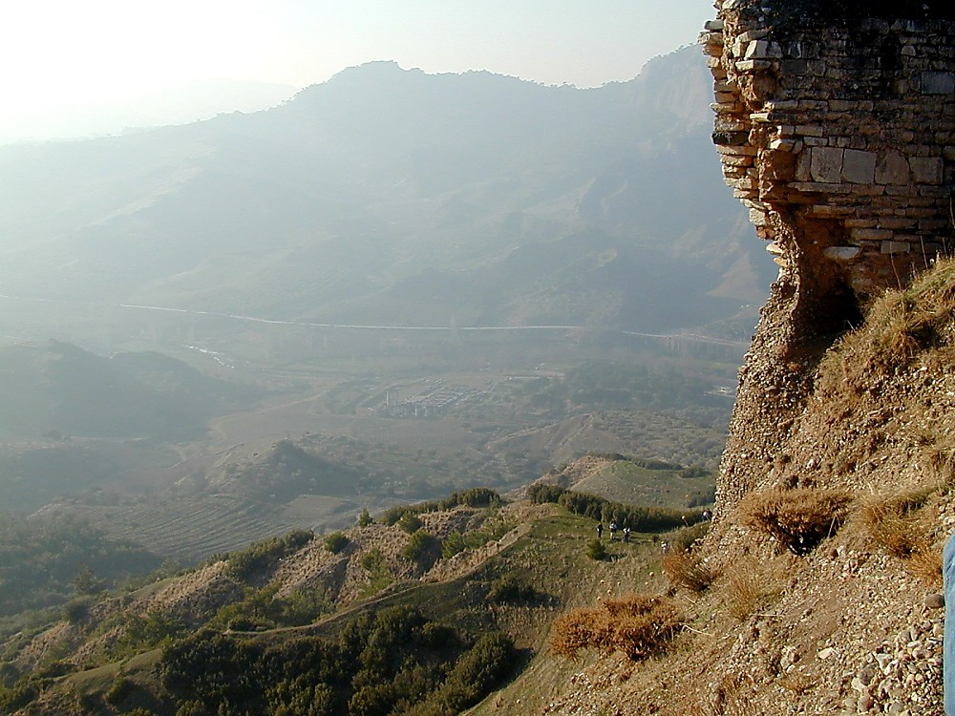
Sardis Temple of Artemis from above
Sardis Temple of Artemis from Above
Notes:
Artemis was held to be one of the patron deities of Sardis, along with Cybele. A temple dedicated to Artemis lies at the foot of the steep acropolis.

Slide 24
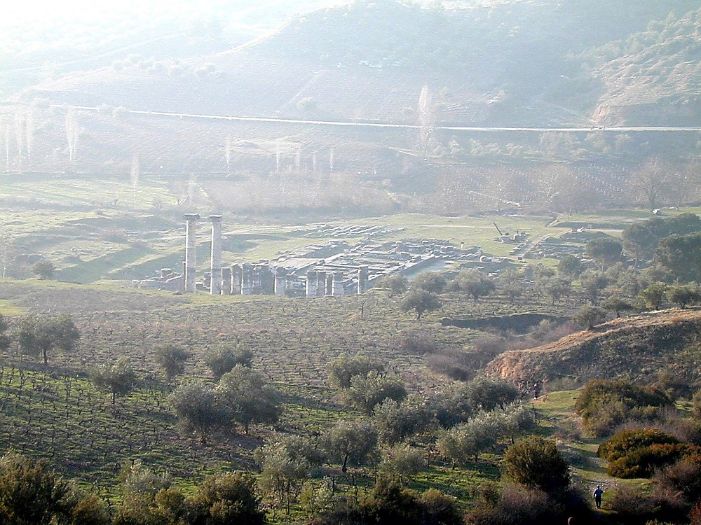
Sardis Temple of Artemis from above
Sardis Temple of Artemis from Above
Notes:
This temple to Artemis was built by Croesus in the 6th century B.C. but was then destroyed in the Ionian Revolt of 499 B.C. It was a magnificent structure, the fourth-largest Ionic-style temple existing in the ancient world. Alexander the Great began to rebuild this temple in 334 B.C. but never finished. Its remains were covered over by landslides from an earthquake in 17 A.D.

Slide 25
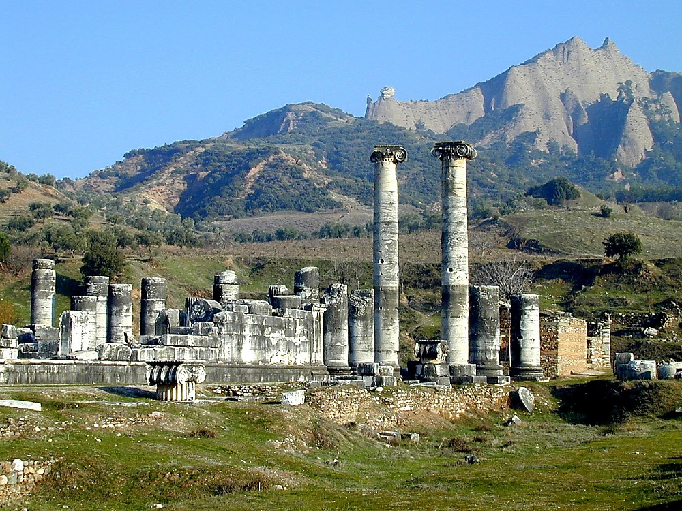
Sardis Temple of Artemis
Sardis Temple of Artemis

Slide 26
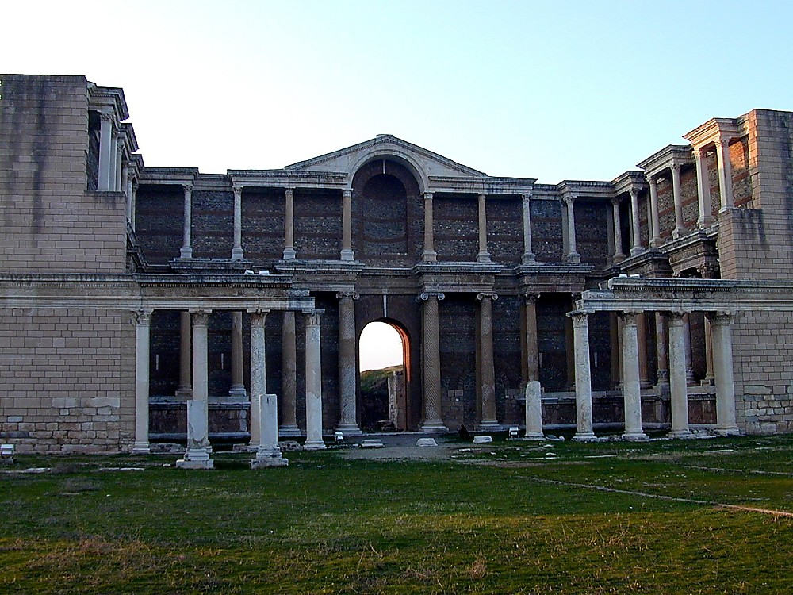
Sardis gymnasium
Sardis Gymnasium

Slide 27
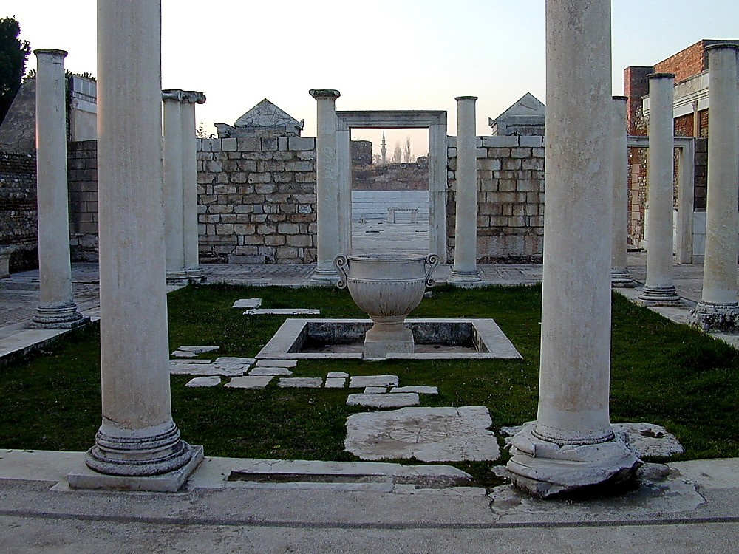
Sardis synagogue, 4th c AD
Sardis Synagogue, 4th c AD
Notes:
Jews in Sardis
There was a large Jewish Diaspora community in Sardis during Roman times, which may have existed for centuries before. The Sepharad (Aramaic name for Sardis) mentioned in Obadiah 20 (these being exiles from Jerusalem ca. 586 B.C.) may refer to Sardis. Seleucid King Antiochus III (late third century B.C.) expanded the Jewish community by means of transferring Jews from Mesopotamia to Lydia.
According to Josephus, Jews of Sardis were granted various privileges during the time of Julius Caesar, including the right to send temple tax to Jerusalem, to have a communal life and conduct suits among themselves, and to receive provisions of ritually clean food.
The approximately eighty inscriptions found in this ostentatious structure reveal that many Jews held high positions, serving on the city council or as wealthy citizens of Sardis. This synagogue (called Beth Alpha) found next to the Marble Hall attests this, since it is the largest synagogue ever found. These remains date to the 4th century A.D., but the three other levels found show that a structure existed here since the 2nd century A.D., although it may have served a different purpose (possibly a basilica).

Slide 28
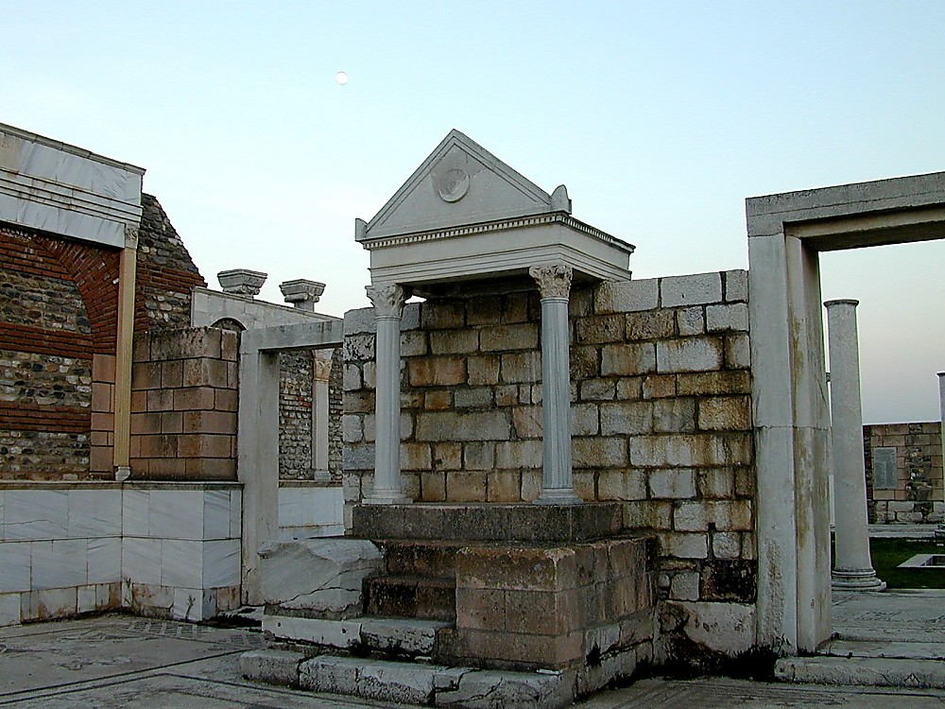
Sardis synagogue bema
Sardis Synagogue Bema

Slide 29
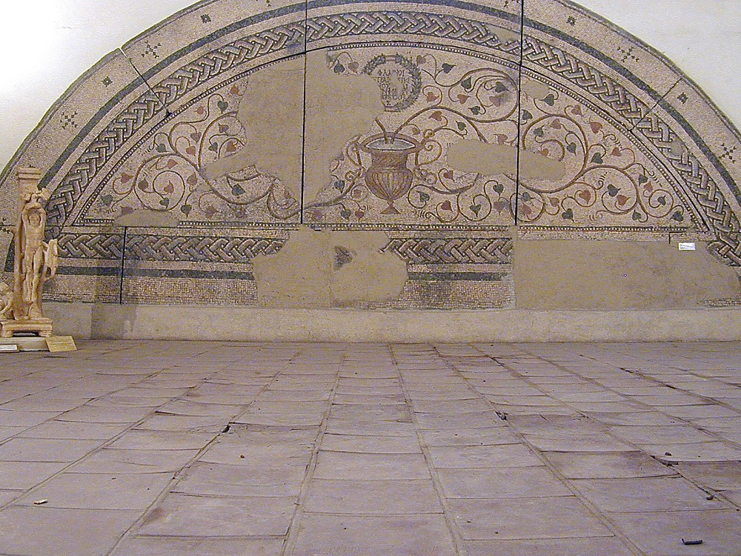
Sardis synagogue mosaic, 400 AD
Sardis Synagogue Mosaic, AD 400

Slide 30
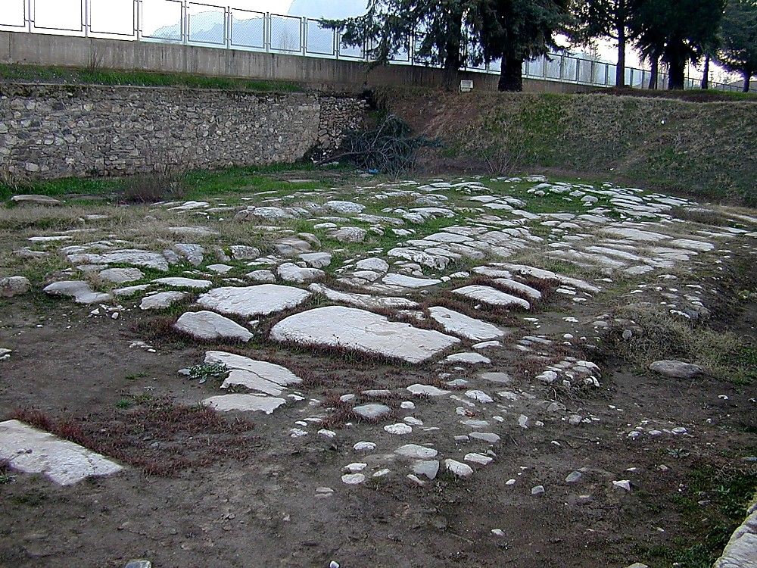
Sardis paved Roman street leading to Persia
Sardis Paved Roman Street Leading to Persia
Notes:
Part of Sardis's prosperity was based upon its location, which was at the crossroads of several major trade routes.

Slide 31
Sardis (Rev. 3:1-6)
357
Pergamum
Thyatira
Christ: Holds the seven spirits of God and the seven stars
Smyrna
Sardis
Ephesus
Philadelphia
Laodicea

Slide 32
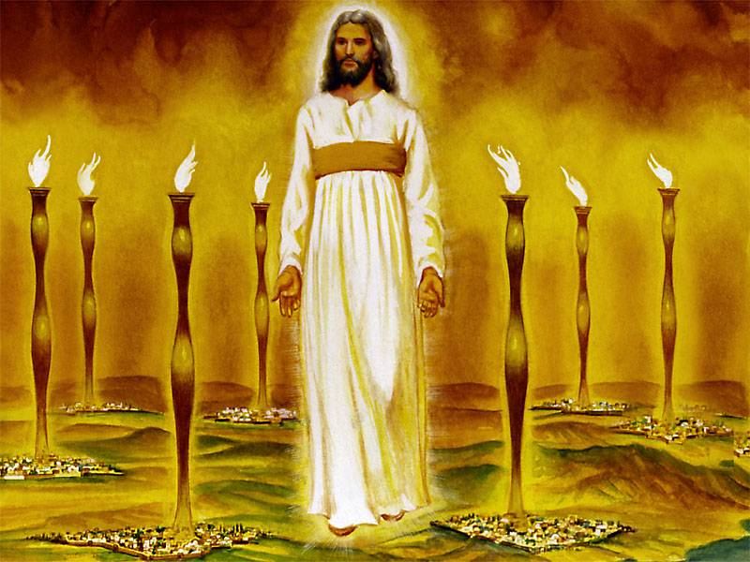
John's vision of the glorified Christ proves He can handle the Church's internal and external problems (1:12-16)
343
Notes:
"Christ's garments are those of a Judge-King, One with honor and authority. The white hair symbolizes His eternality, "the Ancient of Days" (Dan. 7:9, 13, 22). His eyes see all (Rev. 19:12; Heb. 4:12), enabling Him to judge righteously. His feet of burning brass also suggest judgment, since the brazen altar was the place where the fire consumed the sin offering. The Lord had come to judge the churches, and He would also judge the evil world system.
The "sound of many waters" (Rev. 1:15) makes me think of Niagara Falls! Perhaps two ideas are suggested here: (1) Christ gathers together all the "streams of revelation" and is the Father's "last Word" to man (Heb. 1:1–3); (2) He speaks with power and authority and must be heard. The sword from His mouth certainly represents the living Word of God (Heb. 4:12; Eph. 6:17). He fights His enemies by using His Word (Rev. 2:16; 19:19–21)" (Wiersbe).

Slide 33
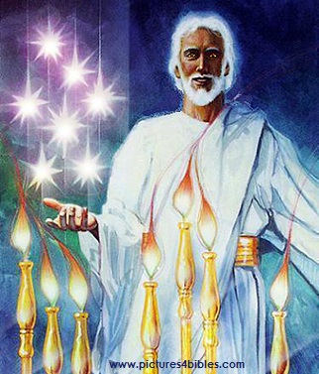
What are the 7 Stars & 7 Lampstands (1:20 NLT)?
"This is the meaning of the mystery of the seven stars you saw in my right hand and the seven gold lampstands: The seven stars are the angels of the seven churches, and the seven lampstands are the seven churches."

Slide 34
Sardis (Rev. 3:1-6)
357
Pergamum
Thyatira
Commendation:
Deeds
Reputation for being alive
Christ: Holds the seven spirits of God and the seven stars
Smyrna
Sardis
Ephesus
Philadelphia
Laodicea

Slide 35
Christ knows all your good deeds and reputation

Slide 36
How much do you care?

Slide 37
I. Jesus knows the good.

Slide 38
II. Jesus knows the bad.

Slide 39
Sardis (Rev. 3:1-6)
357
Pergamum
Thyatira
Rebuke
You are dead
Commendation:
Deeds
Reputation for being alive
Christ: Holds the seven spirits of God and the seven stars
Smyrna
Sardis
Ephesus
Philadelphia
Laodicea

Slide 40
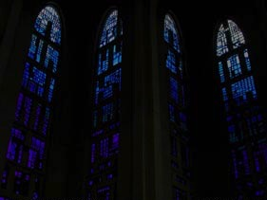
Sardis: Distinguished Yet Dead
357
"You have a reputation for being alive, but in reality you are dead" (3:2)

Slide 41
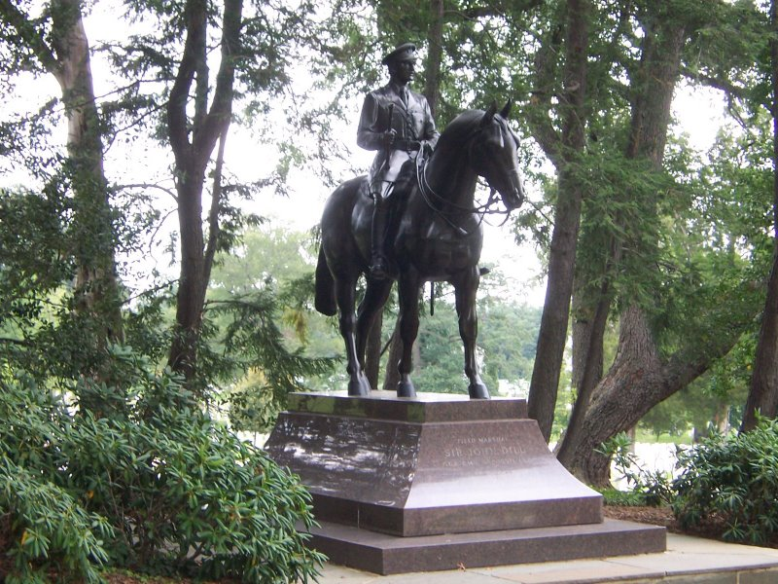
Sardis: Distinguished Yet Dead

Slide 42
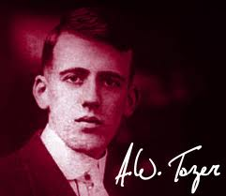
A. W. Tozer
"If the Holy Spirit was withdrawn from the church today, 95 percent of what we do would go on and no one would know the difference. If the Holy Spirit had been withdrawn from the New Testament church, 95 percent of what they did would stop, and everybody would know the difference."
Notes:
http://www.patheos.com/blogs/robertcrosby/2012/05/a-w-tozer-on-the-holy-spirit-todays-church/

Slide 43
Sardis (Rev. 3:1-6)
357
Pergamum
Thyatira
Exhortation
Wake up!
Rebuke
You are dead
Commendation:
Deeds
Reputation for being alive
Christ: Holds the seven spirits of God and the seven stars
Smyrna
Sardis
Ephesus
Philadelphia
Laodicea

Slide 44
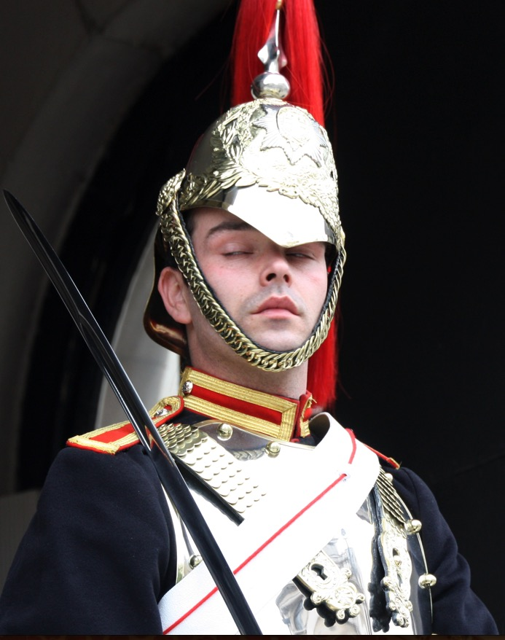
Sardis
358
Wake up! Strengthen what little remains, for even what is left is almost dead… (3:2 NLT).

Slide 45
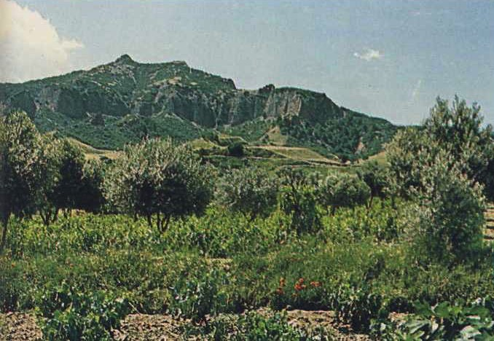
Sardis
358
Sardis stood on this impregnable lookout 457.5 m. (1500 ft.) above the plain. Soldiers of Cyrus (549 BC) and Antiochus (214 BC) conquered it twice by climbing the unguarded north cliff at night when the guards were asleep.

Slide 46
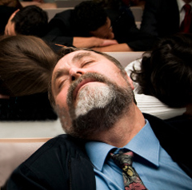
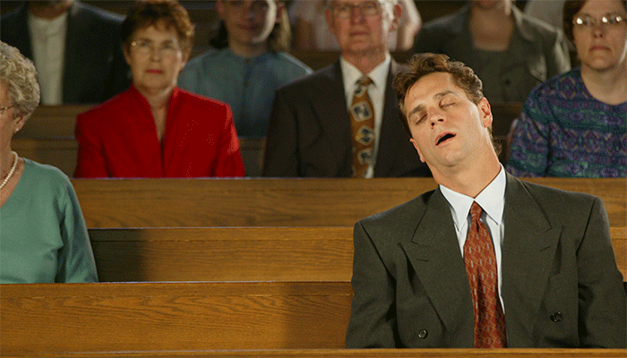
Sleeping in Church

Slide 47
Not Sleeping in Church

Slide 48
Signs Your Pastor Caught You Napping During His Sermon:
He serves you Red Bull during communion
Notes:
http://sacredsandwich.com/archives/8371

Slide 49
Signs Your Pastor Caught You Napping During His Sermon:
He interrupts his sermon to put shaving foam in your hand, then tickles your nose with a feather

Slide 50
Signs Your Pastor Caught You Napping During His Sermon:
He begins questioning his calling due to your inattentiveness, then quits the ministry, starts drinking heavily, and dies alone in a skid row flophouse.
Notes:
http://sacredsandwich.com/archives/8371

Slide 51
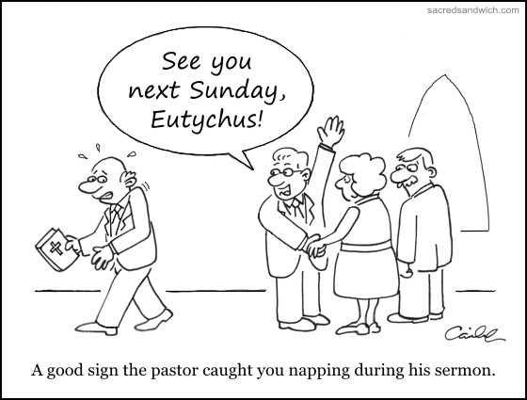
Sleeping in Church
See you next Sunday, Eutychus!
A good sign the pastor caught you napping during his sermon.
Notes:
http://sacredsandwich.com/archives/8371

Slide 52
Sardis (Rev. 3:1-6)
357
Pergamum
Warning
If you do not wake up, I will come like a thief against you
Thyatira
Exhortation
Wake up!
Strengthen what remains
Remember what you received, obey it, repent
Rebuke
You are dead
Commendation:
Deeds
Reputation for being alive
Christ: Holds the seven spirits of God and the seven stars
Smyrna
Sardis
Ephesus
Philadelphia
Laodicea

Slide 53
Sardis
358
Wake up! Strengthen what little remains, for even what is left is almost dead… If you don't wake up, I will come to you suddenly, as unexpected as a thief (3:2-3 NLT).

Slide 54
Wake up!
Known to others and myself
Known only to others
• Family
• Spiritually malnourished
Open
Blind Spot
Hidden
Unknown
http://asalesguy.com/2012/12/11/how-well-do-you-know-you/
Known only to myself
Known to no one
Notes:
Johari's window sums it up nicely like this:
The Open – what others know about us and what we openly share with others
The Hidden – what we know about ourselves that others don't know. (What we keep hidden from site)
The Unknown – what we don't know about ourselves and what others don't know
The Blind Spot – what others know about us, that we don't know about ourselves
The blind spot is where we get tripped up. It's the reason we fail and seem perplexed because we thought we did everything right. It's the date that we thought went awesome yet they don't want to go out with us again. It's the co-worker feeling belittled after you thought you had a super productive meeting. The blind spot is the part of us we just don't see that the rest of the world does that screws everything up.
Do you know your blind spot(s)? Ask around, everyone else does.

Slide 55
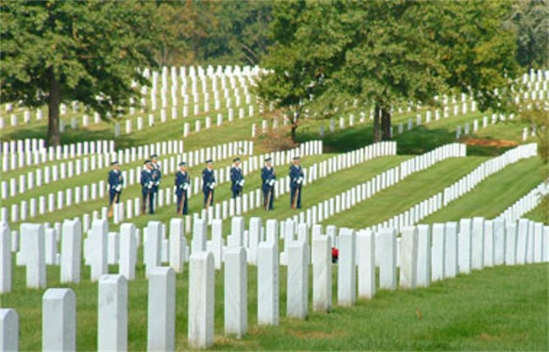
Christ warns us as a church to wake up too
He owns all we have
Caring for people means caring for their kids

Slide 56
I. Jesus knows the good.

Slide 57
II. Jesus knows the bad.

Slide 58
III. Jesus knows the future.

Slide 59
Sardis (Rev. 3:1-6)
357
Promise
Jesus promised believers at Sardis that they are victorious and secure to walk with him in purity (3:4-6)
Pergamum
Warning
If you do not wake up, I will come like a thief against you
Thyatira
Exhortation
Wake up!
Strengthen what remains
Remember what you received, obey it, repent
Rebuke
You are dead
Commendation:
Deeds
Reputation for being alive
Christ: Holds the seven spirits of God and the seven stars
Smyrna
Sardis
Ephesus
Philadelphia
Laodicea

Slide 60
The Overcomers (Rev. 2–3)
365
Pergamum
Thyatira
2:17
2:26
He who overcomes will thus be clothed in white garments; and I will not erase his name from the book of life, and I will confess his name before My Father and before His angels (3:5)
Smyrna
Sardis
2:11
3:5
Ephesus
Philadelphia
2:7
Laodicea

Slide 61
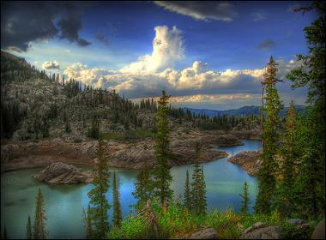
Christ has a fantastic future for you!
"Anyone with ears to hear must listen to the Spirit and understand what he is saying to the churches" (3:6 NLT)

Slide 62
If Jesus wrote a letter to you, what would Jesus say?
R
Revelation

Slide 63
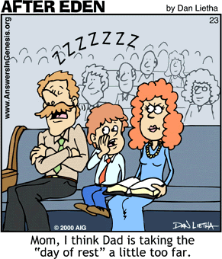
Main Idea?
Don't sleep in church!
Mom, I think Dad is taking the "day of rest" a little too far.

Slide 64
Main Idea:
Jesus knows your good, bad, and future!

Slide 65
Will you wake up?

Slide 66
Will you wake up?

Slide 67
Black

Slide 68
Jesus Wins!
Series on Revelation

Slide 69
NT Sermons link at biblestudydownloads.com
Get this presentation for free!

